Slide 1
Session Tracking Mechanisms

Slide 2
Sessions
Many interactive Web sites spread user data entry out over several pages:
Ex: add items to cart, enter shipping information, enter billing information
Problem: how does the server know which users generated which HTTP requests?
Cannot rely on standard HTTP headers to identify a user

Slide 3
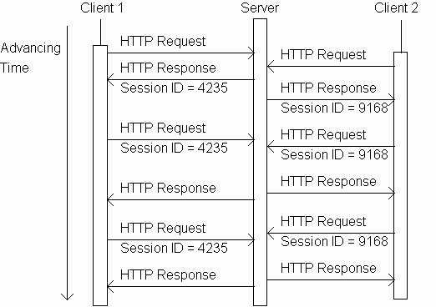
Sessions tracking using session object

Slide 4
Sessions tracking using session object
Server sends back
new unique
session ID when
the request has
none

Slide 5
Sessions tracking using session object
Client that supports
session stores the
ID and sends it
back to the server
in subsequent
requests

Slide 6
Sessions tracking using session object
Server knows
that all of these
requests are
from the same
client. The
set of requests
is known as a
session.

Slide 7
Sessions tracking using session object
And the server
knows that all
of these
requests are
from a different
client.

Slide 8
Methods and Description
public boolean isNew()
returns true if the session is true otherwise false
public String getId()
returns a string containing the unique identifier assigned to the session
public long getCreationTime()
returns the time when this session was created
public long getLastAccessedTime()
returns the last time the client sent a request associated with this session
public void setAttribute(String name, Object value)
Binds an object to this session, using the name specified

Slide 9
Methods and Description
public Object getAttribute(String name)
method returns the object bound with the specified name in this session, or null if no object is bound under the name
public Enumeration getAttributeNames()
This method returns an Enumeration of String objects containing the names of all the objects bound to this session
public int getMaxInactiveInterval()
returns the maximum time interval, in seconds, that the servlet container will keep this session open between client accesses
public void invalidate()
This method invalidates this session and unbinds any objects bound to it

Slide 10

Session Attributes
Code in DoGet() Method
response.setContentType("text/plain");
PrintWriter out = response.getWriter();
// Create a session object
HttpSession session = request.getSession(true);
// Get session creation time.
Date createTime = new Date(session.getCreationTime());
// Get last access time of this web page.
Date lastAccessTime =
new Date(session.getLastAccessedTime());
out.println("Session Id:"+session.getId());
out.println("Date of session creation:"+createTime);
out.println("Last Accessed Time:"+lastAccessTime);
Output

Slide 11
How to check whether the session is new or not?
public class CountServlet extends HttpServlet {
int visits=0;
public void doGet(...)
{
HttpSession session = req.getSession(true);
if(session.isNew())
out.println(“Welcome to the website”);
else
out.println(“Welcome back”);}}

Slide 12
Servlet to count the number of hits
public class CountServlet extends HttpServlet {
int visits=0;
public void doGet(...)
{
visits++;
resp.setContentType("text/plain");
PrintWriter out = resp.getWriter();
out.println(“No of hits”+visits);
}
}

Slide 13
How do we associate different session atrribute to different users?
Associate init parameters in web.xml
<servlet>
<init-param>
<param-name>user1</param-name>
<param-value>praba</param-value>
</init-param>
<init-param>
<param-name>user2</param-name>
<param-value>guna</param-value>
</init-param>
<servlet-name>helloserv</servlet-name>
<servlet-class>CountServlet1</servlet-class>
</servlet>

Slide 14
How do we associate different session attribute to different users?
Index.html
<html>
<body>
<form action="hello" method="get">
<input type="text" name="name">
<input type="text" name="qual">
<input type="submit" value="Submit" />
</form>
</body>
</html>

Slide 15


How do we associate different session atrribute to different users?
public void doGet(..)
{
HttpSession session = req.getSession(true);
resp.setContentType("text/html");
PrintWriter out = resp.getWriter();
out.println("<html><body>");
String login=req.getParameter("name");
String Qual=req.getParameter("qual");
String user=null;
String username=null;
Enumeration enm = getServletConfig().getInitParameterNames();
while (enm.hasMoreElements())
{ username=(String)enm.nextElement();
user=getInitParameter(username);
if(login.equals(user))
{
session.setAttribute(user,Qual);
break;
}
}
out.println("User: " + login);
out.println("Qualification: " + Qual);
Output

